Slide 1
Capacity forecast on DALI data.
Spa
rk
Bram Vonk, JADS-Enexis
July 20 2021

Slide 2
Inhoud komend half uur
Recap vorige sprint review (5 min)
Resultaten sprint
Data (5 min)
Model (10 min)
Werk komende sprint (2 min)
Discussie (8 min)

Slide 3
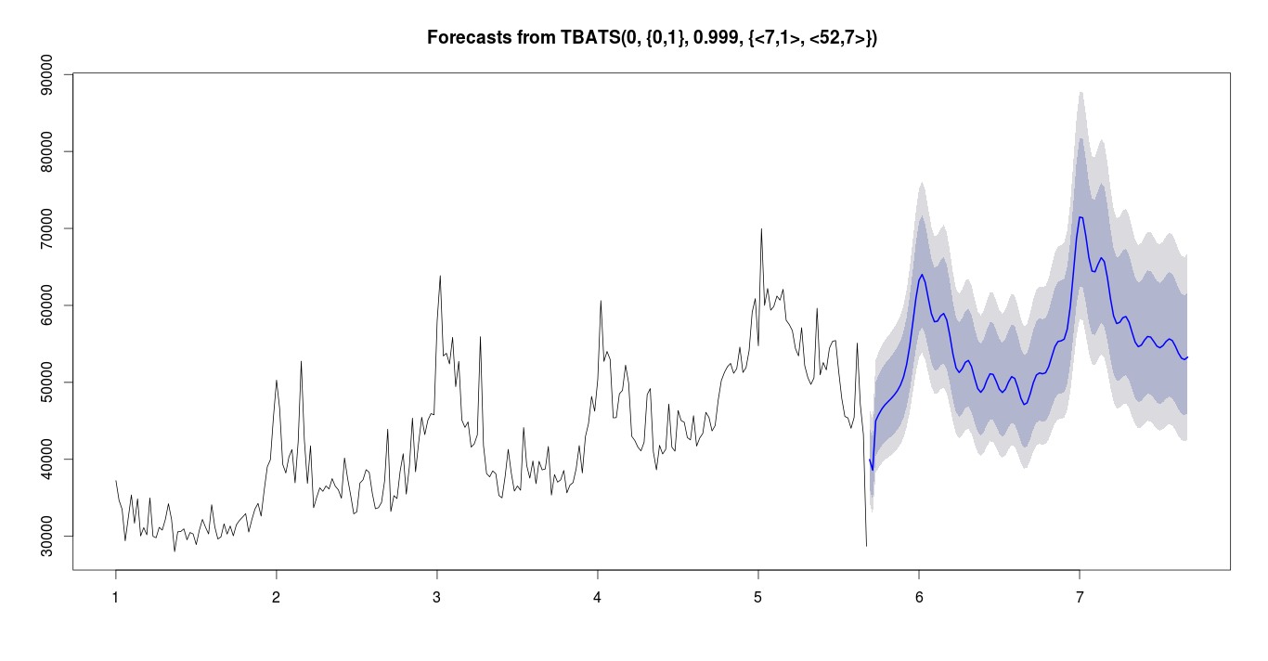
Recap vorige sprint
Project doel
Forecast 6-12 maanden vooruit de capaciteitsvraag op basis van DALI data.
Voorbeeld:
In de herfst kunnen bepalen met bepaalde zekerheid of er in de lente issues komen.
transformer limit
transformer
loading
autumn
spring
historic data
forecast

Slide 4
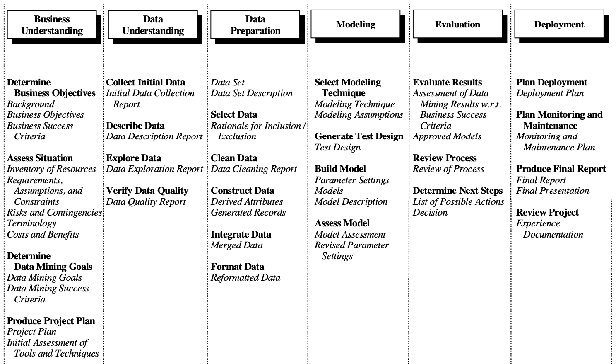
Way of Working vanuit Data Science/JADS: CRISP-DM
Business Understanding
Data Understanding
Data Preperation
Modeling
Evaluation
Deployment

Slide 5
Focus of this sprint
Business Understanding
Data Understanding
Actions Bram
Explore possibility max/min values
Look at data quality
Solution on missing data
Use data in experimental model
Actions Grid Planners
5-10 DALI boxed transformers (with overloading history)

Slide 6
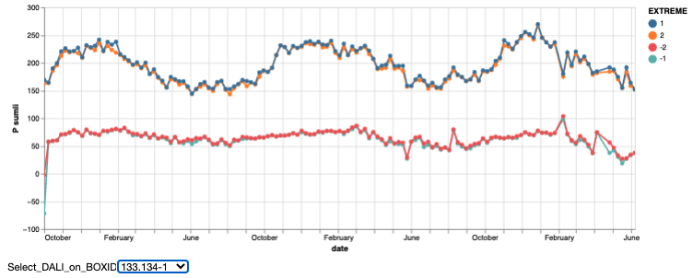
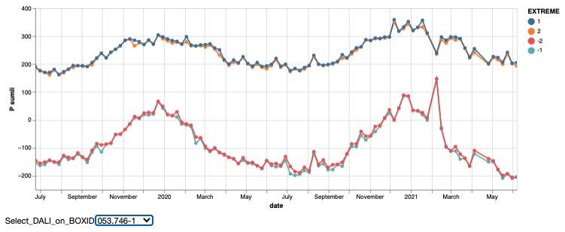
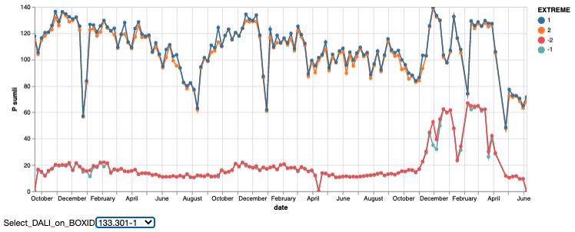
Data
10 random Dali trafo’s from metadata
7/10 existed in measurement table
4/10 had enough data (>2 year history)
General observations
Missing data draws extremes to mean
Completely missing weeks are interpolated
Weekly min and max are sufficient
No added value 2nd extreme (same as 1st)
Simplifies query
Sometimes weird situations (switching?)

Slide 7
Flow Down Business value
Business Value
Safety
Reliability
Affordability
Sustainability
Company KPI
Overloading
Outage
Claims
Ad hoc resources
Planned resources
Project KPI
Do nothing
Ad hoc replacement
Stop growth
Planned replacement
Possible actions
Optimal planning transformer replacement
Model Usage
Forecast Model
Transformer overloaded soon
Model result
Future timeseries P / S DALI
Y variables
Nominal power of transformer
Historic timeseries P / S DALI
X Variables

Slide 8
Requirements for achieving value
Model
Explainable
Forecast has prediction intervals
Forecast horizon 6-12 months
Uses prior information of population (if data is limited)
Usage tool
No separate log in/install
Quick visualisation of results (no waiting)
Scalable up to 35k transformers
Sorting on urgency
Reliable (tool + forecast)
Export results possible for other tools (e.g. Vision, Power BI dashboards)

Slide 9
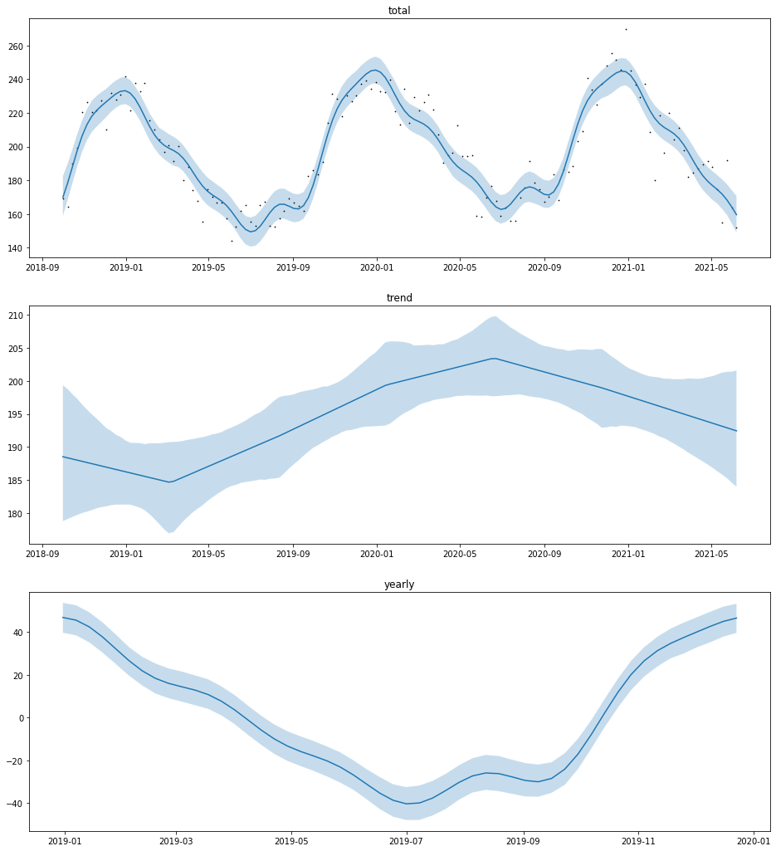
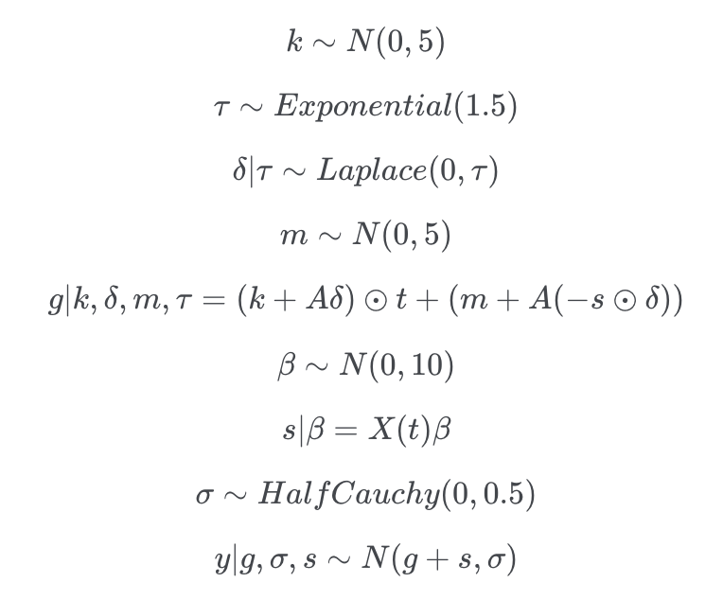
Model structure
Generalized Additive Model
Picked DALI box 133.134-1
Total = trend + year component

Slide 10
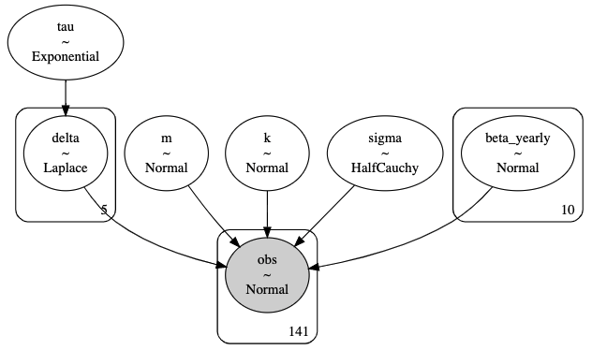
Model structure
Generalized Additive Model
Picked DALI box 133.134-1
Total = trend + year component

Slide 11
Model parameter estimation
On historic / observed data
95% quantile band (needs attention)
Issues with scaling of data for estimation

Slide 12
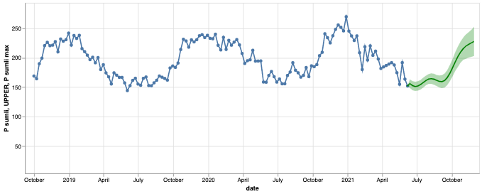
Forecasting with model
First impression → not too bad
Next step → validation with data
Request → overloading use cases

Slide 13
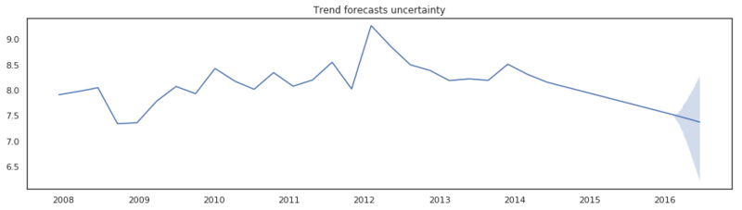
Issue with trend changepoints
Proposal:
Only changepoints on observations, not on expectations.

Slide 14
Focus komende sprint (in september, na verlof)
Data Preparation
Verder met
Data Preparation → set op S3
Model → opzetten testcases

Slide 15
Discussion

